Slide 1
Gen AI-Based Data Profiling & Validation
Automating Regulatory Data Validation with AI
Presented By : TeamAIData
Date : 03/26

Slide 2
Introduction
Problem: Data validation is time-consuming and complex.
Solution: Automate validation rule extraction using AI.
Benefits: Faster, more accurate data validation with AI-powered insights.

Slide 3
Features
Extracts validation rules from PDFs.
AI-powered rule extraction (Hugging Face API).
Generates validation code dynamically.
Provides validation statistics & insights.

Slide 4
How It Works
Upload a regulatory PDF.
Extract validation rules manually or using AI.
Upload a CSV file.
Validate data against extracted rules.
Download results.

Slide 5
Technical Architecture
Frontend: Streamlit
Backend: Python, Pandas, pdfplumber, Hugging Face API
Data Processing: Regex-based rule parsing, AI-generated validation code

Slide 6
AI Integration
Uses Hugging Face API to extract rules.
Customizable AI prompt.
Generates structured JSON output for validation.

Slide 7
Error Handling & Edge Cases
Handles missing/ambiguous rules.
AI fallback for missing manual rules.
Custom error messages for execution failures.

Slide 8
Future Improvements
Support for more regulatory formats.
AI fine-tuning for better rule extraction.
Improved UI for validation insights.

Slide 9
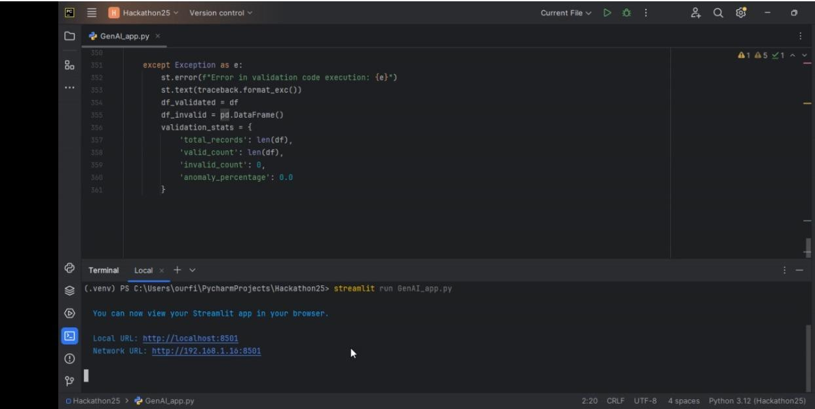
Snapshots

Slide 10
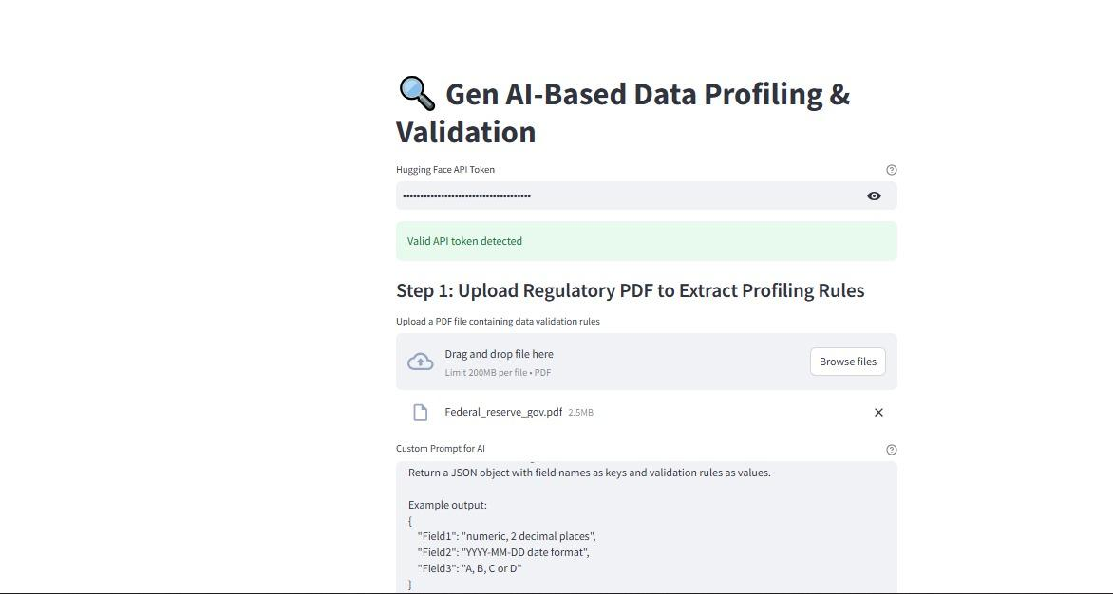
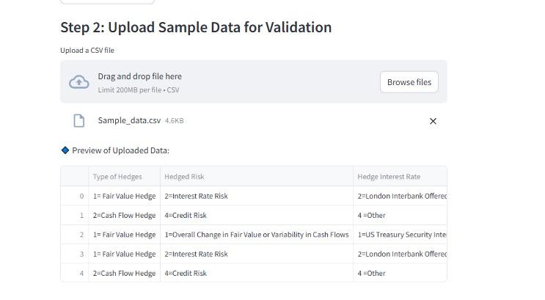

Slide 11
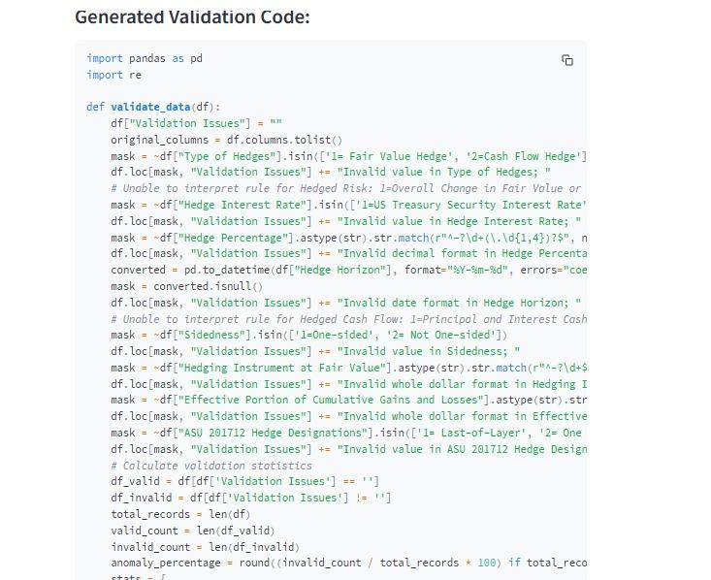

Slide 12
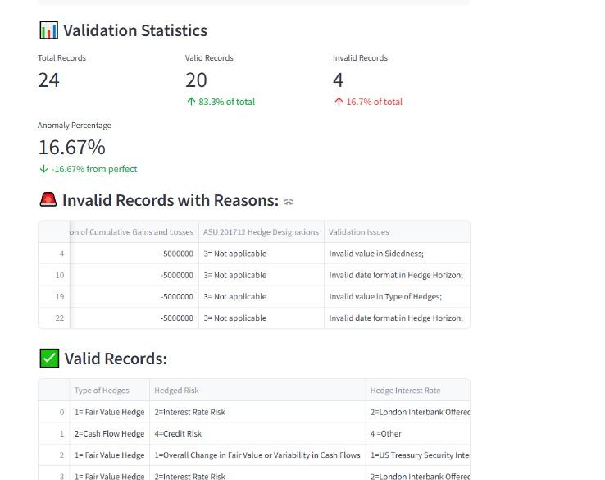

Slide 13
Conclusion & Q&A
Summary of benefits:
Automated rule extraction
AI-powered validation
Faster, more reliable compliance

